Slide 1
The Chubby lock service for loosely-coupled distributed systems
Presented by Petko Nikolov
Cornell University
3/12/09

Slide 2
Before Chubby Came About…
Wide range of distributed systems
Clients in the 10,000s
How to do primary election?
  Ad hoc (no harm from duplicated work)
  Operator intervention (correctness essential)
Disorganized
Costly
Low availability

Slide 3
Motivation
Need for service that provides
  synchronization (leader election, shared env. info.)
  reliability
  availability
  easy-to-understand semantics
  performance, throughput, latency only secondary
NOT research

Slide 4
Outline
Primary Election
  Paxos
Design
Use and Observations
Related Work

Slide 5
Primary Election
Distributed consensus problem
Asynchronous communication
  loss, delay, reordering
FLP impossibility result
Solution: Paxos protocol

Slide 6
Paxos: Problem
Collection of processes proposing values
  only proposed value may be chosen
  only single value chosen
  learn of chosen value only when it has been
Proposers, acceptors, learners
Asynchronous, non-Byzantine model
  arbitrary speeds, fail by stopping, restart
  messages not corrupted

Slide 7
Paxos: Algorithm
Phase 1
(a) Proposer sends prepare request with #n
(b) Acceptor: if n > # of any other prepare it has replied to, respond with promise.
Phase 2
(a) If majority reply, proposer sends accept with value v
(b) Acceptor accepts unless it responded to prepare with # higher than n

Slide 8
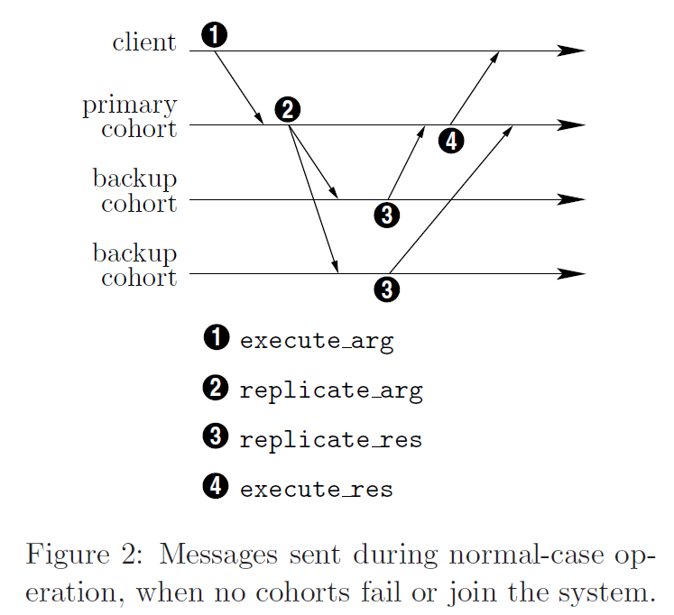
Paxos: Algorithm

Slide 9
Paxos: Algorithm
Learning of chosen value
  distinguished learner optimization
    has pitfalls
Making progress
  distinguished proposer
Usually, every process plays all roles
  primary as distinguished proposer and learner

Slide 10
Paxos: State Machines
Replicated state machine
  same state if same sequence of ops. performed
Client sends requests to server
  replicated with Paxos
Paxos used to agree on order of client ops.
  can have failures / more than 1 master
  Paxos guarantees only 1 value chosen & replicated

Slide 11
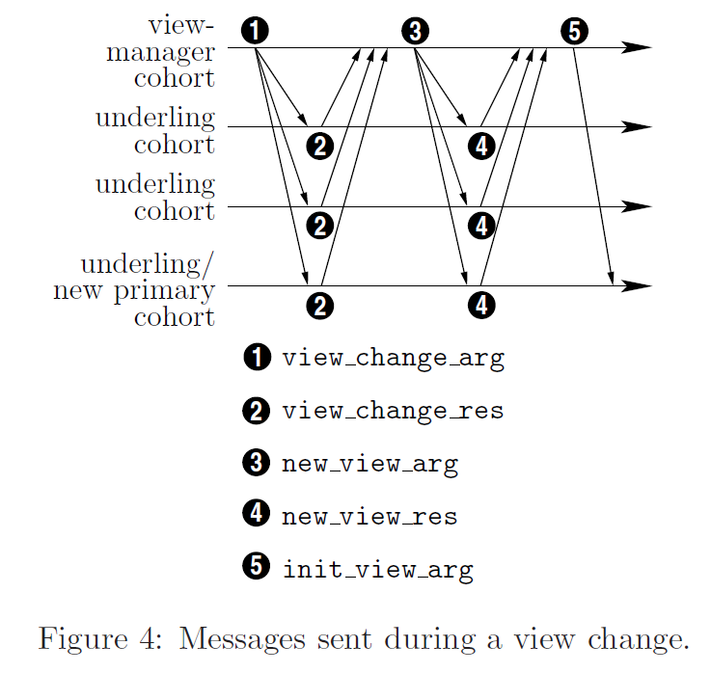
Paxos: View Change

Slide 12
Design
Lock service (and not consensus library)
Serve small files
Support large-scale concurrent file viewing
Event notification mechanism
Caching of files (consistent caching)
Security (access control)
Course-grained locks

Slide 13
Design: Rationale
Lock service vs. Paxos library
Advantages
  maintain program structure, comm. patters
  mechanism for advertising results
  persuading programmers to use it
  reduce # of client servers needed to make progress

Slide 14
Design: Rationale
Course-grained locks
  less load on lock server
  less delay when lock server fails
  should survive lock server failures
  less lock servers and availability required
Fine-grained locks
  heavier lock server load, more client stalling on fail
  can be implemented on client side

Slide 15
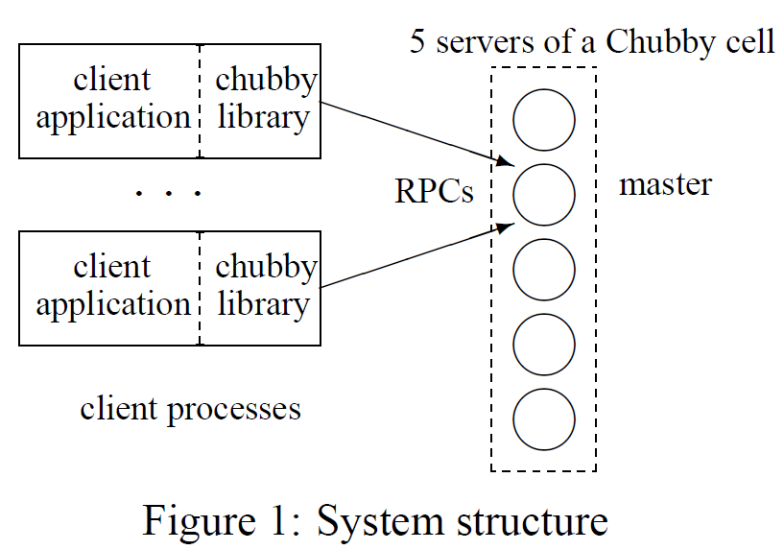
Design: System Structure
Two main components:
  server (Chubby cell)
  client library
  communicate via RPC
Proxy
  optional
  more on this later

Slide 16
Design: Chubby Cell
Set of replicas (typically 5)
Use Paxos to elect master
  promise not to elect new master for some time (master lease)
Maintain copies of simple database
Writes satisfied by majority quorum
Reads satisfied by master alone
Replacement system for failed replicas

Slide 17
Design: Chubby Clients
Link against library
Master location requests to replicas
All requests sent directly to master

Slide 18
Design: Files, Dirs, Handles
FS interface
  /ls/cs6464-cell/lab2/test
  specialized API
  also via interface used by GFS
Does not support/maintain/reveal
  moving files
  path-dependent permission semantics
  dir modified times / file last-access times

Slide 19
Design: Nodes
permanent vs. ephemeral
Metadata
  three names of ACLs (R/W/change ACL name)
    authentication built into RPC
  4 monotonically increasing 64-bit numbers
    instance, content generation, lock generation, ACL gen.
  64-bit file-content checksum

Slide 20
Design: Handles
Analogous to UNIX file descriptors
Check digits
  prevent client creating/guessing handles
Support for use across master changes
  sequence number
  mode information for recreating state

Slide 21
Design: Locks and Sequencers
Any node can act as lock (shared or exclusive)
Advisory (vs. mandatory)
  protect resources at remote services
  debugging / admin. purposes
  no value in extra guards by mandatory locks
Write permission needed to acquire
  prevents unprivileged reader blocking progress

Slide 22
Design: Locks and Sequencers
Complex in async environment
Use sequence #’s in interactions using locks
Sequencer
  opaque byte-string
  state of lock immediately after acquisition
  passed by client to servers, servers validate
Alternative: lock-delay

Slide 23
Design: Events
Client subscribes when creating handle
Delivered async via up-call from client library
Event types
  file contents modified
  child node added / removed / modified
  Chubby master failed over
  handle / lock have become invalid
  lock acquired / conflicting lock request (rarely used)

Slide 24
Design: API
Open() (only call using named node)
  how handle will be used (access checks here)
  events to subscribe to
  lock-delay
  whether new file/dir should be created
Close() vs. Poison()
Other ops:
  GetContentsAndStat(), SetContents(), Delete(), Acquire(), TryAcquire(), Release(), GetSequencer(), SetSequencer(), CheckSequencer()

Slide 25
Design: API
Primary election example
Candidates attempt to open lock file / get lock
  winner writes identity with SetContents()
  replicas find out with GetContentsAndStat(), possibly after file-modification event
Primary obtains sequencer (GetSequencer())

Slide 26
Design: Sessions and KeepAlives
Session maintained through KeepAlives
Handles, locks, cached data remain valid
  client must acknowledge invalidation messages
Terminated explicitly, or after lease timeout
Lease timeout advanced when
  session created
  master fail-over occurs
  master responds to KeepAlive RPC

Slide 27
Design: Sessions and KeepAlives
Master responds close to lease timeout
Client sends another KeepAlive immediately

Slide 28
Design: Sessions and KeepAlives
Handles, locks, cached data remain valid
  client must acknowledge invalidation messages
Cache invalidations piggybacked on KeepAlive
  client must invalidate to maintain session
  RPC’s flow from client to master
  allows operation through firewalls

Slide 29
Design: Sessions and KeepAlives
Client maintains local lease timeout
  conservative approximation
  must assume known restrictions on clock skew
When local lease expires
  disable cache
  session in jeopardy, client waits in grace period
  cache enabled on reconnect
Application informed about session changes

Slide 30
Design: Caching
Client caches file data, node meta-data
  write-through held in memory
Invalidation
  master keeps list of what clients may have cached
  writes block, master sends invalidations
  clients flush changed data, ack. with KeepAlive
  data uncachable until invalidation acked
    allows reads to happen without delay

Slide 31
Design: Caching
Invalidates data but does not update
  updating arbitrarily unefficient
Strict vs. weak consistency
  weaker models harder to use for programmers
  do not want to alter preexisting comm. protocols
Handles and locks cached as well
  event informs client of conflicting lock request
Absence of files cached

Slide 32
Design: Fail-overs
In-memory state discarded
  sessions, handles, locks, etc.
Lease timer “stops”
Quick re-election
  client reconnect before leases expire
Slow re-election
  clients disable cache, enter grace period
  allows sessions across fail-overs

Slide 33
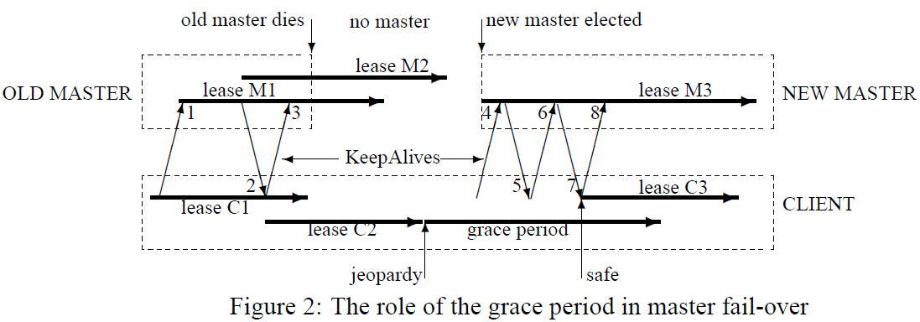
Design: Fail-overs

Slide 34
Design: Fail-overs
Steps of newly-elected master:
Pick new epoch number
Respond only to master location requests
Build in-memory state for sessions / locks from DB
Respond to KeepAlives
Emit fail-over events to caches
Wait for acknowledgements / session expire
Allow all operations to proceed

Slide 35
Design: Fail-overs
Steps of newly-elected master (cont’d):
Handle created pre-fail-over used
  master recreates in memory, honors call
  if closed, record that in memory
Delete ephemeral files w/o open handles after an interval
Fail-over code source of many bugs

Slide 36
Design: Database
First Chubby used replicated Berkeley DB
  with master lease added on
Replication code was new
  did not want to take the risk
Implemented own simple database
  distributed using consensus protocol

Slide 37
Design: Backup
Every few hours
Snapshot of database to GFS server
  different building
    building damage, cyclic dependecies
Disaster recovery
Initialize new replica
  avoid load on in-service replicas

Slide 38
Design: Mirroring
Collection of files mirrored across cells
Mostly for configuration files
  /ls/global/master mirrored to /ls/cell/slave
    global cell’s replicas spread around world
  Chubby’s own ACLs
  Files advertising presence / location
  pointers to Bigtable cells
  etc.

Slide 39
Mechanisms for Scaling
Clients individual processes (not machines)
  observed 90,000 clients for a single master
Server machines identical to client ones
Most effective scaling: reduce communication
Regulate # of Chubby cells
Increase lease time
Caching
Protocol-conversion servers

Slide 40
Scaling: Proxies
Proxies pass requests from clients to cell
Can handle KeepAlives and reads
Not writes, but they are << 1% of workload
KeepAlive traffic by far most dominant
Disadvantages:
  additional RPC for writes / first time reads
  increased unavailability probability
  fail-over strategy not ideal (will come back to this)

Slide 41
Scaling: Partitioning
Namespace partitioned between servers
N partitions, each with master and replicas
Node D/C stored on P(D/C) = hash(D) mod N
  meta-data for D may be on different partition
Little cross-partition comm. desirable
  permission checks
  directory deletion
  caching helps mitigate this

Slide 42
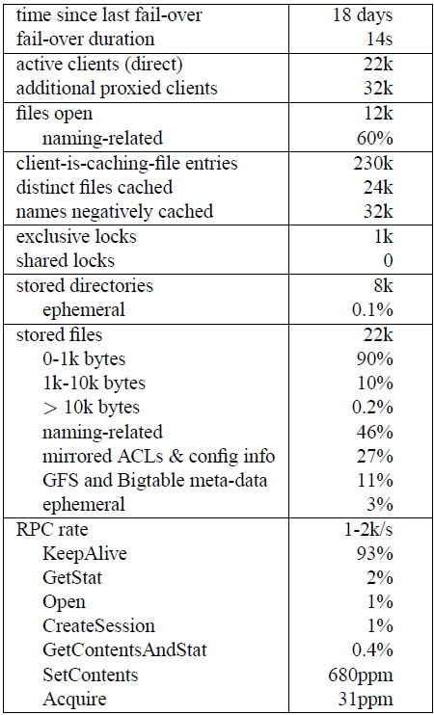
Use and Observations
Many files for naming
Config, ACL, meta-data common
10 clients use each cached file, on avg.
Few locks held, no shared locks
KeepAlives dominate RPC traffic

Slide 43
Use: Outages
Sample of cells
  61 outages over few weeks (700 cell-days)
  due to network congestion, maintenance, overload, errors in software, hardware, operators
52 outages under 30s
  applications not significantly affected
Few dozen cell-years of operation
  data lost on 6 occasions (bugs & operator error)

Slide 44
Use: Java Clients
Most of Google infrastructure is in C++
Growing # of Java applications
Googlers dislike JNI
  would rather translate library to Java
  maintaining it would require great expense
Java users run protocol-conversion server
  exports protocol similar to Chubby’s client API

Slide 45
Use: Name Service
Most popular use of Chubby
  provides name service for most Google systems
DNS uses TTL values
  entries must be refreshed within that time
  huge (and variable) load on DNS server
Chubby’s caching uses invalidations, no polling
  client builds up needed entries in cache
  name entries further grouped in batches

Slide 46
Use: Name Service
Name service
  no full consistency needed
  reduce load with protocol-conversion server
Chubby DNS server
  naming data available to DNS clients
  eases transition between names
  accommodates browsers

Slide 47
Use: Fail-over Problems
Master writes sessions to DB when created
  start of many processes at once = overload
DB modified – store session at first write op.
  read-only sessions: at random on KeepAlives
  spread out writes to DB in time
Young read-only sessions may be “discarded”
  may read stale data for a while after fail-over
  very low probability

Slide 48
Use: Fail-over Problems
New design – no sessions in database
  recreate them like handles after fail-over
  new master waits full lease time before ops.
    little effect – very low probability
Proxy servers can manage sessions
  allowed to change session a lock is associated with
    permits takeover of session by another proxy on fail
  master gives new proxy chance to claim locks before relinquishing them

Slide 49
Use: Abusive Clients
Company environment assumed
Requests to use Chubby thoroughly reviewed
Abuses:
  lack of aggressive caching
    absence of files, open file handles
  lack of quotas
    256kB limit on file size introduced
    encouraged use of appropriate storage systems
  publish/subscribe

Slide 50
Use: Lessons Learned
Developers rarely consider availability
  should plan for short Chubby outages
  crashed applications on fail-over event
Fine-grained locking not essential
Poor API choices
  handles acquiring locks cannot be shared
RPC use affects transport protocols
  forced to send KeepAlives by UDP for timeliness

Slide 51
Related Work
Chubby
Boxwood
locks, storage system, session/lease in one service
target audience – wide range
higher-level interface
lost lock expensive for clients
could use locks and sequencers with other systems
3 separate services
  lock, Paxos, failure detection
  could be used independently
fewer, more sophisticated developers
different default parameters
lacks grace period
uses locks primarily within

Slide 52
Summary
Distributed lock service
  course-grained synchronization for Google’s distributed systems
Design based on well-known ideas
  distributed consensus, caching, notifications, file-system interface
Primary internal name service
Repository for files requiring high availability

Slide 53
References
The Chubby lock service for loosely-coupled distributed systems, Mike Burrows. Appears in Proceedings of the 7th USENIX Symposium on Operating Systems Design and Implementation (OSDI), November, 2006. http://labs.google.com/papers/chubby-osdi06.pdf
Paxos Made Simple, Leslie Lamport. Appears in ACM SIGACT News (Distributed Computing Column), Vol. 32, No. 4 (December 2001), pages 51-58. http://research.microsoft.com/en-us/um/people/lamport/pubs/paxos-simple.pdf Also,
Paxos Made Practical by David Mazieres http://www.cs.cornell.edu/courses/cs6464/2009sp/papers/paxos_practical.pdf

